Slide 1
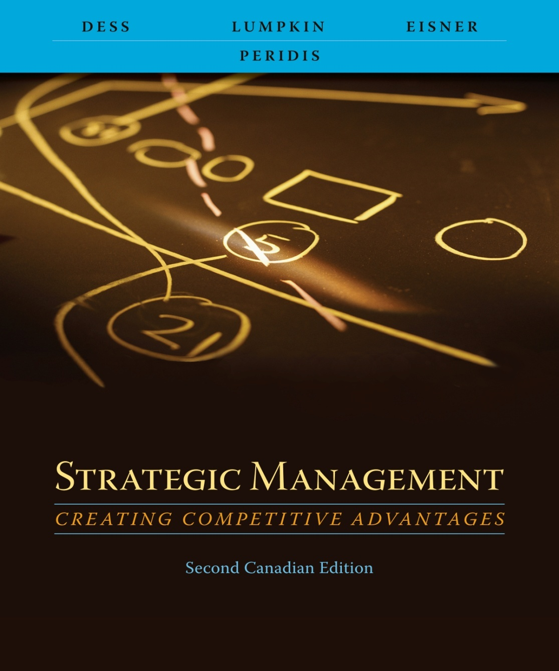
Chapter 2
Analyzing the External Environment

Slide 2
Learning Objectives
After reading this chapter, you should have a good understanding of:
  The elements that constitute a firm’s general environment and their impact on the firm’s strategies and performance.
  How to define the competitive environment and delineate industry boundaries.
  Why environmental scanning, environmental monitoring, and collecting competitive intelligence are critical inputs to developing forecasts of the business environment.
  Why scenario planning is a useful technique for firms competing in industries characterized by unpredictability and change.
  How trends and event in the general environment and forces in the competitive environment are interrelated and affect performance.
  How forces in the competitive environment can affect profitability and how a firm can improve its competitive position by increasing its power vis-à-vis these forces.
  The concept of strategic groups and their strategy and performance implications.
Copyright © 2009 McGraw-Hill Ryerson Limited .
2-2

Slide 3




Creating the Environmentally
Aware Organization
Adapted from Exhibit 2.1 Inputs to Forecasting
Copyright © 2009 McGraw-Hill Ryerson Limited .
2-3

Slide 4
Environmental Scanning
Surveillance of a firm’s external environment
  Predict environmental changes to come
  Detect changes already under way
  Proactive mode
Track evolution of
  Environmental trends
  Sequences of events
  Streams of activities
Copyright © 2009 McGraw-Hill Ryerson Limited .
2-4

Slide 5
Competitive Intelligence
Define and understand a firm’s industry
Identify rivals’ strengths and weaknesses
  Intelligence gathering (data)
  Interpretation of intelligence data
Helps a firm avoid surprises
Copyright © 2009 McGraw-Hill Ryerson Limited .
2-5

Slide 6
What Competitive Intelligence
Is and Is Not
Competitive Intelligence Is …
Information that has been analyzed to the point where you can make a decision.
A tool to alert management to early recognition of both threats and opportunities.
A means to deliver reasonable assessments.
A way of life, a process.
Competitive Intelligence Is Not …
Spying. Spying implies illegal or unethical activities. It is a rare activity.
A crystal ball. CI is good approximation of reality, it does not predict the future.
Database search. Data by itself is not good intelligence.
A job for one smart person.
Adapted from Exhibit 2.2 What Competitive Intelligence (CI) Is and Is Not
Copyright © 2009 McGraw-Hill Ryerson Limited .
2-6

Slide 7
Environmental Forecasting
Plausible projections about
  Direction of environmental change
  Scope of environmental change
  Speed of environmental change
  Intensity of environmental change
Copyright © 2009 McGraw-Hill Ryerson Limited .
2-7

Slide 8
Scenario Analysis
Coping with unpredictability and uncertainty
  Considering the possible impact of major shifts in social, technological, demographic, and political trends on the broad environment and the re-drawing of the industry
  Changes in the “rules of the game”
Copyright © 2009 McGraw-Hill Ryerson Limited .
2-8

Slide 9
SWOT Analysis
Managers need to analyze
  The general environment
  The firm’s industry and competitive environment
SWOT analysis
  Strengths
  Weaknesses
  Opportunities
  Threats
  Basic technique for analyzing firm and industry conditions
Copyright © 2009 McGraw-Hill Ryerson Limited .
2-9

Slide 10
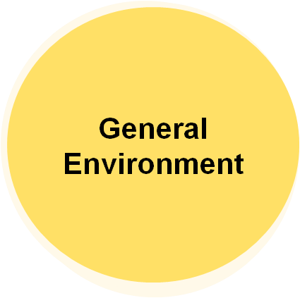
The General Environment
General environmental trends and events
  Little ability to predict them
  Even less ability to control them
  Can vary across industries
Demographic
Sociocultural
Political/Legal
Technological
Economic
Global
Copyright © 2009 McGraw-Hill Ryerson Limited .
2-10

Slide 11
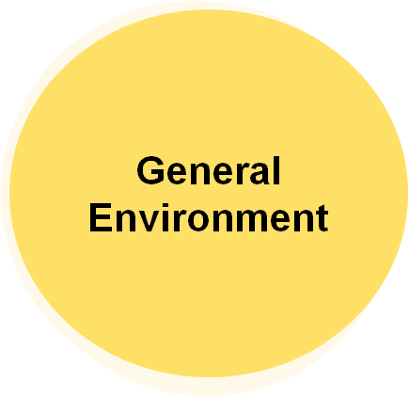
Demographic Segment
Aging population
Rising affluence
Changes in ethnic composition
Geographic distribution of population
Disparities in income levels
Demographic
Sociocultural
Political/Legal
Technological
Economic
Global
Copyright © 2009 McGraw-Hill Ryerson Limited .
2-11

Slide 12
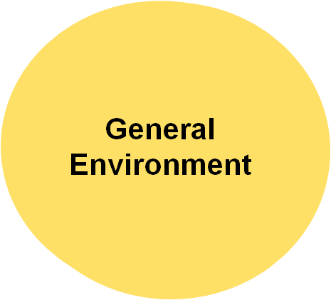
Sociocultural Segment
More women in the workforce
Increase in temporary workers
Greater concern for fitness
Greater concern for environment
Postponement of family formation
Demographic
Sociocultural
Political/Legal
Technological
Economic
Global
Copyright © 2009 McGraw-Hill Ryerson Limited .
2-12

Slide 13
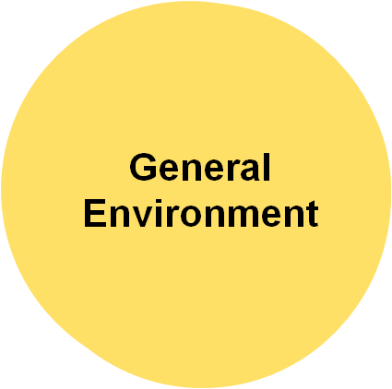
Political/Legal Segment
Protection of cultural industries
Aboriginal land claims settlements
Deregulation of utility and other industries
Increases in provincially mandated minimum wages
Taxation at provincial and federal levels
Legislation on corporate governance reforms
Demographic
Sociocultural
Political/Legal
Technological
Economic
Global
Copyright © 2009 McGraw-Hill Ryerson Limited .
2-13

Slide 14
Technological Segment
General Environment
Genetic engineering
Emergence of Internet technology
Computer-aided design/computer-aided manufacturing systems (CAD/CAM)
Research in synthetic and exotic materials
Pollution/global warming
Miniaturization of computing technologies
Wireless technology
Demographic
Sociocultural
Political/Legal
Technological
Economic
Global
Copyright © 2009 McGraw-Hill Ryerson Limited .
2-14

Slide 15
Economic Segment
General Environment
Interest rates
Unemployment
Consumer Price index
Trends in GDP
Changes in stock market valuations
Demographic
Sociocultural
Political/Legal
Technological
Economic
Global
Copyright © 2009 McGraw-Hill Ryerson Limited .
2-15

Slide 16
Global Segment
General Environment
Increasing global trade
Currency exchange rates
Emergence of the Indian and Chinese economies
Trade agreements among regional blocs (NAFTA, EU, ASEAN)
Creation of WTO (decreasing tariffs/free trade in services)
Demographic
Sociocultural
Political/Legal
Technological
Economic
Global
Copyright © 2009 McGraw-Hill Ryerson Limited .
2-16

Slide 17
The Competitive Environment
Competitive Environment
Sometimes called the task or industry environment
Includes
  Competitors (existing and potential)
  Customers
  Suppliers
Porter’s five-forces model
Competitors
Customers
Suppliers
Copyright © 2009 McGraw-Hill Ryerson Limited .
2-17

Slide 18





Porter’s Five Forces Model of
Industry Competition
Threat of
new entrants
Bargaining power of suppliers
Bargaining power of buyers
Threat of
Substitute products and services
Adapted from Exhibit 2.5 Porter’s Five Forces Model of Industry Competition
Copyright © 2009 McGraw-Hill Ryerson Limited .
2-18

Slide 19
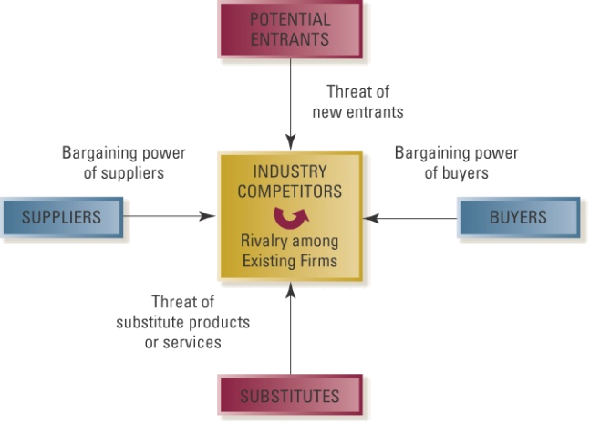
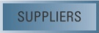

The Threat of New Entrants
Profits of established firms in the industry may be eroded by new competitors
High entry barriers lead to low threat of new entries
  Economies of scale
  Product differentiation
  Capital requirements
  Switching costs
  Access to distribution channels
  Cost disadvantages independent of scale
Copyright © 2009 McGraw-Hill Ryerson Limited .
2-19

Slide 20
The Bargaining Power of Buyers
Buyers threaten an industry
  Force down prices
  Bargain for higher quality or more services
  Play competitors against each other
Copyright © 2009 McGraw-Hill Ryerson Limited .
2-20

Slide 21
The Bargaining Power of Buyers
A buyer group is powerful when
  It is concentrated or purchases large volumes relative to seller sales
  The products it purchases from the industry are standard or undifferentiated
  The buyer faces few switching costs
  It earns low profits
  The buyers pose a credible threat of backward integration
  The industry’s product is unimportant to the quality of the buyer’s products or services
Copyright © 2009 McGraw-Hill Ryerson Limited .
2-21

Slide 22
The Bargaining Power of Suppliers
Suppliers can exert power by threatening to raise prices or reduce the quality of purchased goods and services
Copyright © 2009 McGraw-Hill Ryerson Limited .
2-22

Slide 23
The Bargaining Power of Suppliers
A supplier group will be powerful when
  The supplier group is dominated by a few companies and is more concentrated than the industry it sells to
  The supplier group is not obliged to contend with substitute products for sale to the industry
  The industry is not an important customer of the supplier group
Copyright © 2009 McGraw-Hill Ryerson Limited .
2-23

Slide 24
The Bargaining Power of Suppliers
A supplier group will be powerful when
  The supplier’s product is an important input to the buyer’ business
  The supplier group’s products are differentiated or it has built up switching costs for the buyer
  The supplier group poses a credible threat of forward integration
Copyright © 2009 McGraw-Hill Ryerson Limited .
2-24

Slide 25
The Threat of Substitute Products and Services
Substitutes limit the potential returns of an industry
  Ceiling on the prices that firms in that industry can profitably charge
  Price/performance ratio
Copyright © 2009 McGraw-Hill Ryerson Limited .
2-25

Slide 26
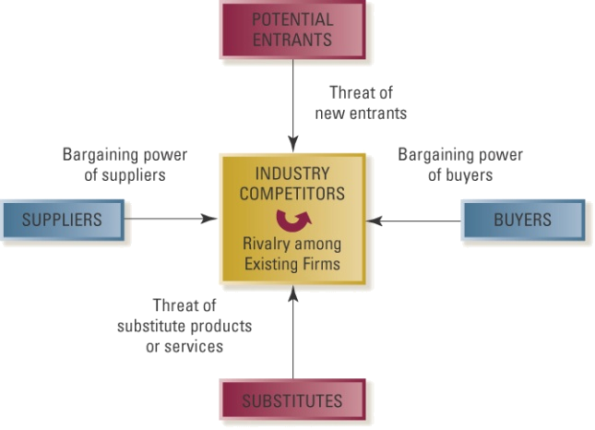

The Intensity of Rivalry among Competitors in an Industry
Jockeying for position
Price competition
Advertising battles
Product introductions
Increased customer service or warranties
Copyright © 2009 McGraw-Hill Ryerson Limited .
2-26

Slide 27
The Intensity of Rivalry among Competitors in an Industry
Interacting factors lead to intense rivalry
  Numerous or equally balanced competitors
  Slow industry growth
  High fixed or storage costs
  Lack of differentiation or switching costs
  Capacity augmented in large increments
  High exit barriers
Copyright © 2009 McGraw-Hill Ryerson Limited .
2-27

Slide 28
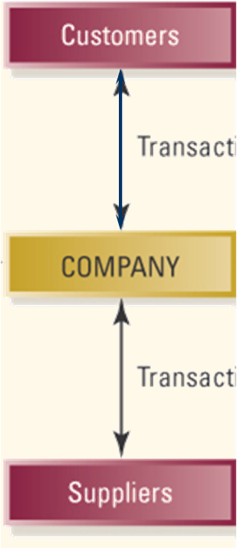
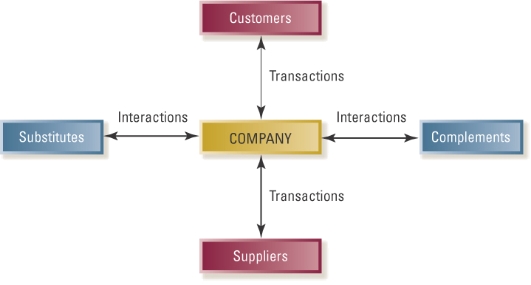
The Value Net
Transactions
Interactions
Interactions
Transactions
Adapted from Exhibit 2.7 The Value Net
Copyright © 2009 McGraw-Hill Ryerson Limited .
2-28

Slide 29
Strategic Groups within Industries
Two unassailable assumptions in industry analysis
  No two firms are totally different
  No two firms are exactly the same
Strategic groups
  Cluster of firms that share similar strategies
    Breadth of product and geographic scope
    Price/quality
    Degree of vertical integration
    Type of distribution system
Copyright © 2009 McGraw-Hill Ryerson Limited .
2-29

Slide 30
Strategic Groups within Industries
Value of strategic groups as an analytical tool
  Identify barriers to mobility that protect a group from attacks by other groups
  Identify groups whose competitive position may be marginal or tenuous
  Chart the future direction of firms’ strategies
  Thinking through the implications of each industry trend for the strategic group as a whole
Copyright © 2009 McGraw-Hill Ryerson Limited .
2-30

